Slide 1
OCR GCSE Computer Science
Unit 2.2 Programming Fundamentals

Slide 2
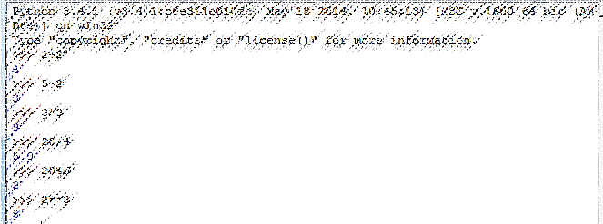
Unit 2.2 Programming Fundamentals Part 1
Programming Fundamentals

Slide 3
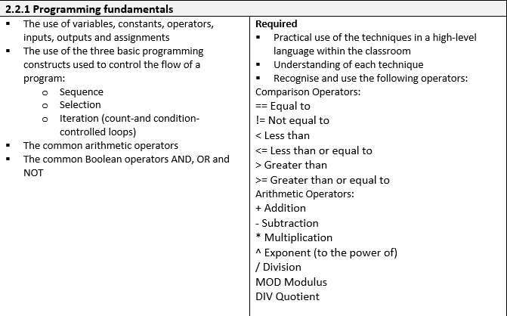
What will we learn in Unit 2.2 Part 1?

Slide 4
The use of Variables
Programs and algorithms often contain variables. The name that you give to a variable is its identifier.
It is much easier to understand what the program or algorithm is doing if you use a meaningful identifier.
E.g. radius=8 The identifier for this variable is radius.
Radius
8

Slide 5

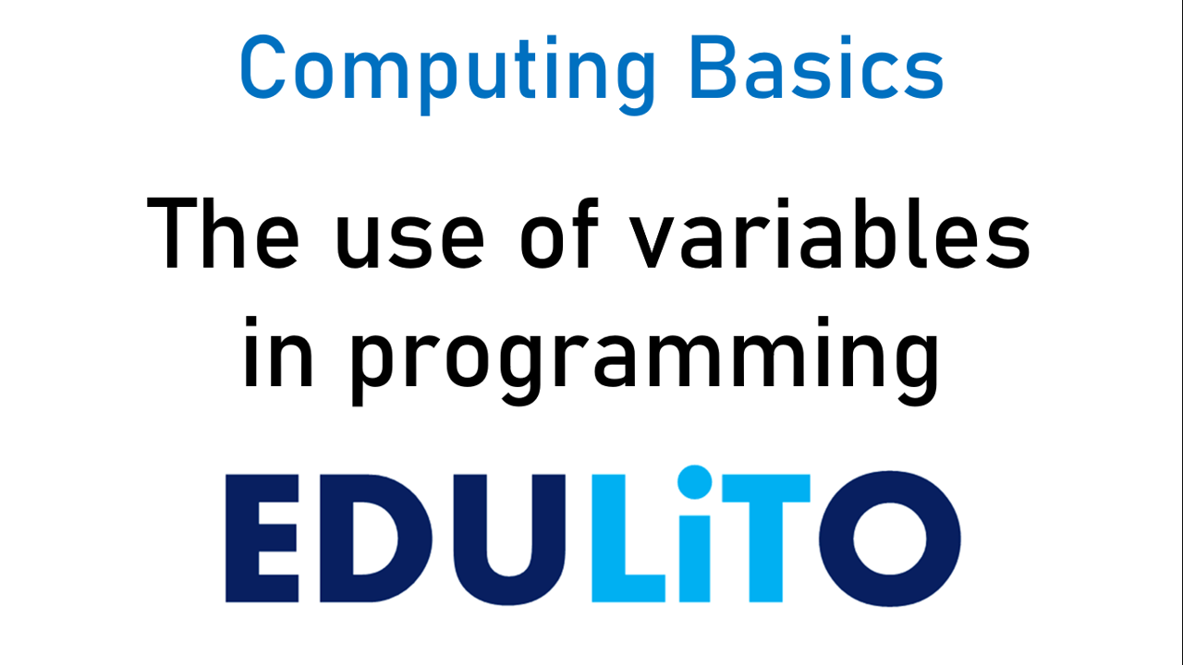
Video

Slide 6
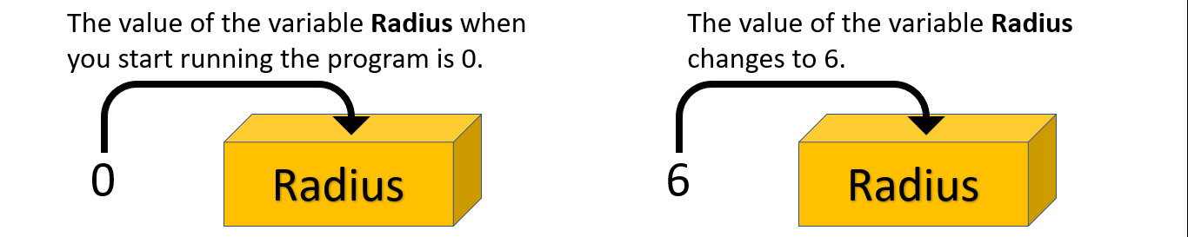
The use of Variables
When you run a program the variable can change its value (that’s why it’s called a variable.
When you choose an identifier, make sure that it helps the person using the program understand what the variable stores.

Slide 7
Choosing a Suitable Identifier
It shouldn’t be too long as you may have to write it lots of times and it’s also less likely to be misspelt.
Only use an identifier that is a bit longer if there is no alternative.
Remember that programs have “reserved words” i.e. words you can’t use as an identifier. E.g. the word input is a reserved word.
If you are using a programming language they often have their own rules about identifiers. E.g. in Python identifiers must be one word and cannot start with a number.

Slide 8
Assigning a Values to a Variable
The processes of giving a variable a value is called assigning.
E.g.
You might assign the value Alyssa to the variable name.
Name
Alyssa

Slide 9
Assigning a Values to a Variable
You might assign the value 1.83 to the variable height.
A variable is declared the first time a value is assigned.
When you are using Python = means assign NOT equals
In Python equals is ==
Height
1.83

Slide 10

The Use of Constants
A constant is a value that cannot be changed whilst the program is running, the value stays the same.
E.g. In a program used to calculate the area of a circle, pi is a constant.

Slide 11
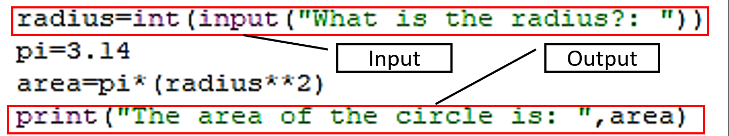
Inputs and Outputs
Any data that is required by the algorithm/program is called an input.
A program can have one or many inputs. Output from a program occurs after the data has been processed. E.g. The output could be an image or some text appearing on you computer screen, it could turn a motor on or it could play an audio file.

Slide 12
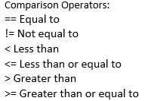
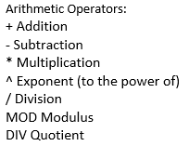
Operators
The operators used in algorithms/programs are the same as the operators that you use in Maths.

Slide 13

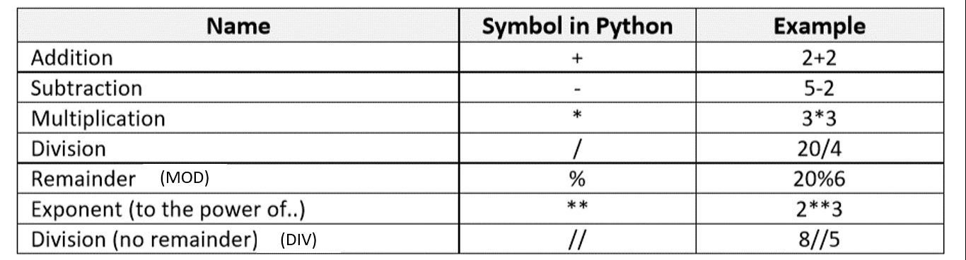
Arithmetic Operators in Python

Slide 14
CHECKPOINT
1. Write a program that asks a person their first name, their surname and the name of their favourite animal. The program then displays a sentence that welcomes them and says who they are and what their favourite animal is.
2. How many variables did you use in the program?

Slide 15
Programming Constructs
Algorithms and programs are developed using just three main programming constructs:
Sequence
Selection
Iteration
These programming constructs are used to control the flow of a program.

Slide 16
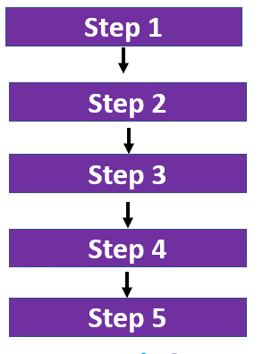
Programming Constructs: Sequence
An algorithm is a step by step set of instructions for solving problems. If these steps occur one after another then the programming construct used is said to be a sequence.

Slide 17
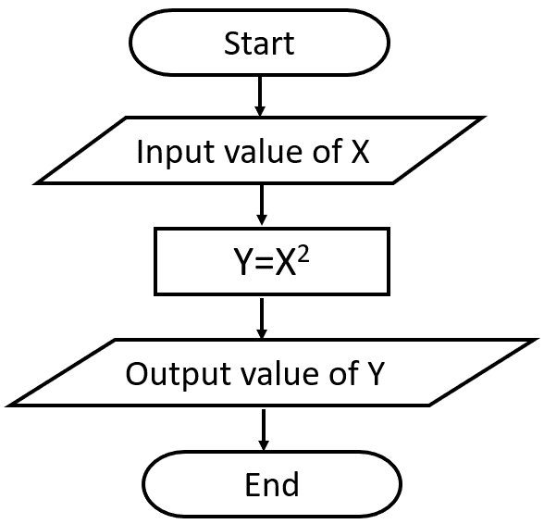
Sequences can be written as a Flowchart

Slide 18
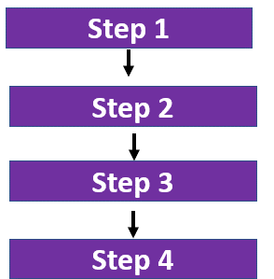

Sequences can be used with Python Programs

Slide 19
Programming Constructs: Selection
When you use a sequence programming construct there is no choice, after step 2 you have step 3. Whereas, when you use the Selection programming construct, there is a choice. You can select more than one path.
Selection means making decisions. The decision is based on the answer you give to a particular question.
Shall I turn on the light?
If the answer is YES then turn on the light
If the answer is NO then do not turn on the light

Slide 20
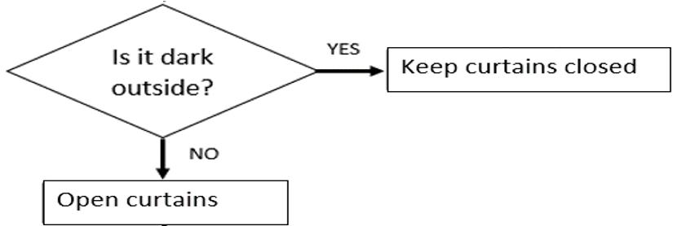
Selection can be written as a Flowchart

Slide 21
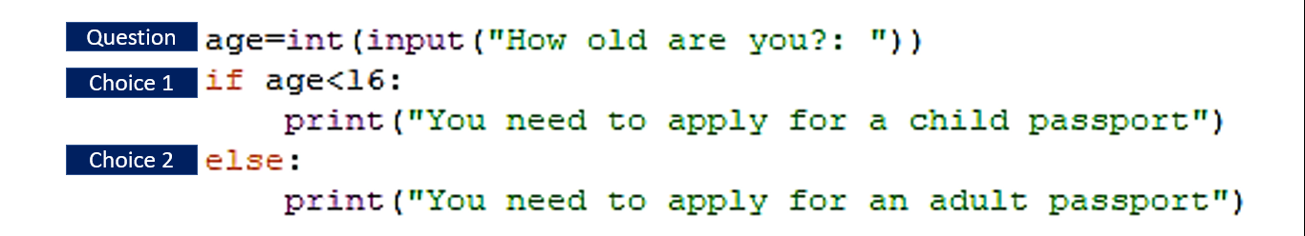
Selection – Making a Choice

Slide 22
Selection: IF – THEN - ELSE
If-then-else is commonly used to provide the choice in a selection.
Using OCR reference language:
answer=input(“Is GCSE Computer Science fun?: “)
if answer == "Yes" then
print("Correct")
elseif answer == "No" then
print("Wrong")
else
print("Error")
endif

Slide 23
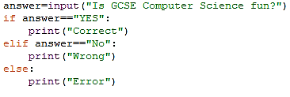
Selection: IF – THEN - ELSE
This is how it would appear in Python.

Slide 24
Selection: Case Select or Switch
Selection can also operate with more than a binary choice. To do this you must use a Case Select or Switch Selection.
Here is an example in OCR reference language.
switch day :
case "Sat":
print("Saturday")
case "Sun":
print("Sunday")
default:
print("Weekday")
endswitch

Slide 25
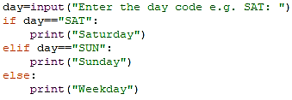
Selection: Case Select or Switch in Python
This can be done in Python using dictionaries, but at GCSE level, using if and elif statements can be used.

Slide 26
CHECKPOINT
You work for passport control. You have been asked to write a program that sends out the correct form for passport renewal. If the person applying for the passport is under 16 they will need to be sent a “Child” application form. Anyone else applying must be sent the “Adult” application form.
You work for Twitter and you have been asked to create a program that informs the user if they have used too many characters in their message. The program allows you to enter your message and then the program calculates the length of the message in characters. If the message is greater than 280 characters, you get a warning message to say that your message is too long. (Hint: You will need to use len(variable_name) ).

Slide 27
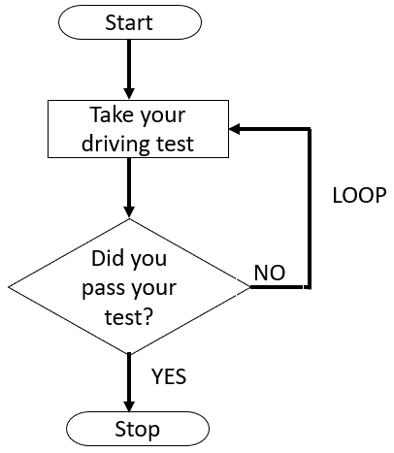
Programming Constructs: Iteration
Iteration means to repeat a process until there is the desired outcome.
For example, if you fail your driving test you take it again. You will repeat this process until you pass your test.
Program constructs that use iteration are called loops.

Slide 28
Types of Iteration
There are two main types of iteration:
Count Controlled Loops –The number of loops is known before the loop is executed.
Condition Controlled Loops - The number of loops is not known before the loop is executed. The loop will stop when the condition used becomes true or false.

Slide 29
Count Controlled Loop: For Loop
A For Loop is an example of a count controlled loop.
Using OCR Reference language:
for i=0 to 9
print(“Hello")
next i
This loop will display the word Hello 10 times, as i will be 0 then 1 then 2………until………9

Slide 30
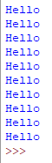

Count Controlled Loop: For Loop
Here is the same For loop in Python. Notice that the last number in the range is 10 rather than 9, as the loop stops before the last number in the range.

Slide 31

Count Controlled Loop: While Loop
It is also possible to use a While loop as a count-controlled loop, but this is less commonly used than a For loop.

Slide 32

Count Controlled Loops: For Loop
Loops can be used to make a program much more efficient.
What is the purpose of this program?

Slide 33
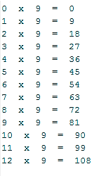
Count Controlled Loop: For Loop

Slide 34
CHECKPOINT
1. Use a FOR loop to display numbers from 1 to 10.
2. Use a FOR loop to display numbers from 2 to 20 in steps of 2
3. Use a FOR Loop to display the word SCHOOL so that one letter from the word appears on each line.
5. Produce a program that uses only 4 lines of code that will display the 2 to 12 times table.

Slide 35
Iteration: Condition Controlled Loops
When you use a condition controlled loop, the number of iterations is not known before you start the loop. The loop uses a condition, and the loop will stop when this condition becomes true or false.
There are two types of condition controlled loops:
While loop -The condition is checked at the beginning of the code block.
Do While loop - The condition is checked at the end of the code block.

Slide 36
Condition Controlled Loop: While Loop
This while loop will continue to loop until the user inputs the string “Correct”. Notice that the while loop checks that the condition is carried out before entering the loop.
Using OCR Reference language:
while answer != “Paris"
answer = input(“What is the capital of France?: “)
endwhile

Slide 37
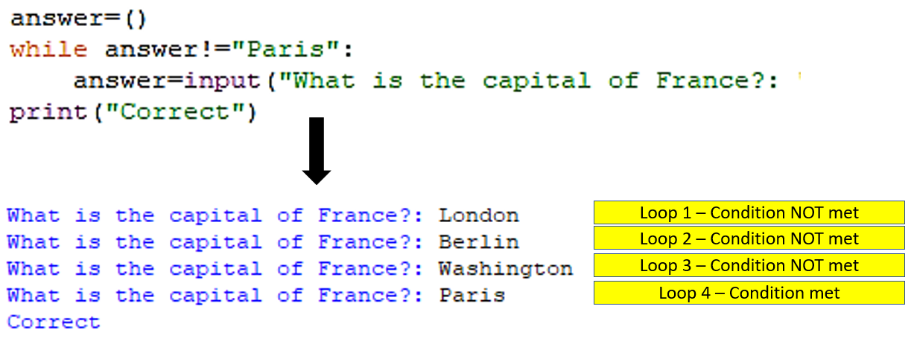
Condition Controlled Loop: While Loop
Here is the same while loop in Python.

Slide 38
Condition Controlled Loop: Do While Loop
When using a Do While loop continues while the condition remains false. The condition is checked at the end of the code block therefore it is always run at least once.
Using OCR Reference language:
do
answer = input(“What is the capital of France?: ")
until answer == “Paris"

Slide 39

Condition Controlled Loop: Do While Loop
In Python there is no Do While loop. It is possible to use While True to start the program in this case it will continue until the condition is met.
An If statement is used to check whether the condition is met and if the condition is met break is used to leave the loop.

Slide 40


Nested Loops
Nested loops occur when you have one loop inside another loop (It’s indented). They can be used with count controlled and condition controlled loops.
Nested Loop

Slide 41
CHECKPOINT
Create a program that adds up a series of numbers to find the total. The program asks for your first number and adds this number to the total. It then asks the question would you like to add another number. If the user replies yes they are then asked for another number. If the user replies no the program stops and displays the total.

Slide 42
Comparison Operators
Comparison operators are important components in many programs. When you use the selection programming construct you must use a comparison operator to help make a decision.
E.g.
if x>=y then
print(x, “is greater than” ,y)
else
print(y, ”is greater than2,x)
endif

Slide 43
Comparison Operators
Comparison operators are also important components when you use the iteration programming construct. In particular, condition controlled loops, as the condition requires a comparison.
E.g.
x=20
y=10
while x>y
print(x,y)
x=x-2
endwhile

Slide 44
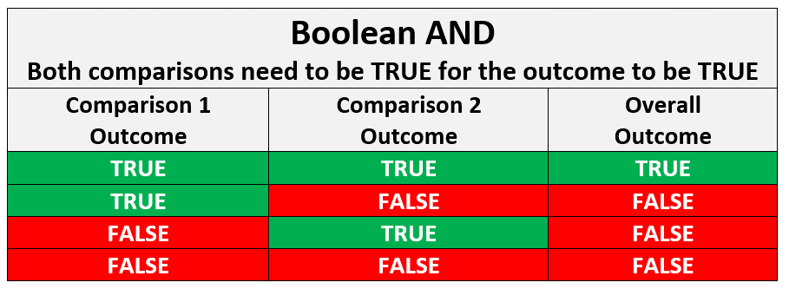
Boolean Operators: Truth Tables
These are used to make decisions about the outcomes of two comparisons.

Slide 45
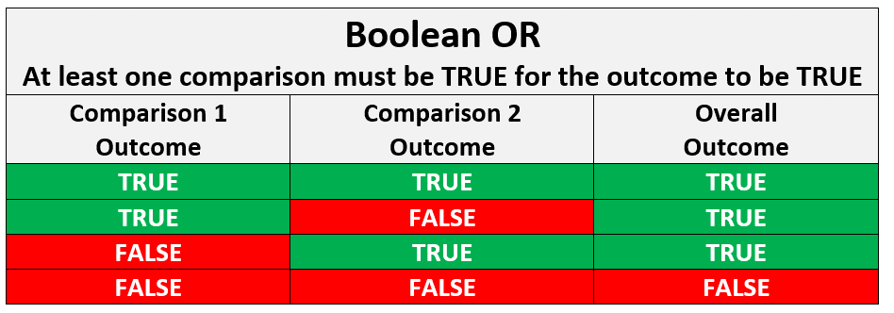
Boolean Operators: Truth Tables
These are used to make decisions about the outcomes of two comparisons.

Slide 46
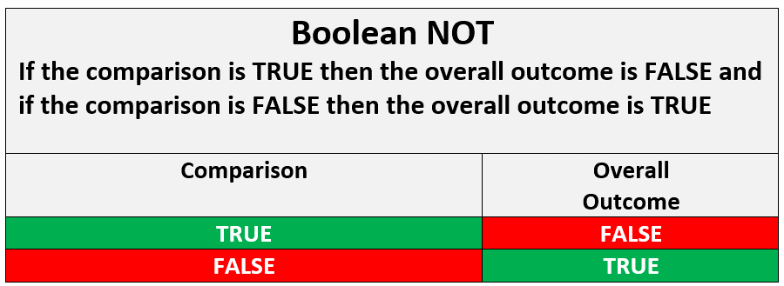
Boolean Operators: Truth Tables
These are used to make decisions about the outcome of a comparison.

Slide 47
Boolean Operators
Boolean operators are also used in algorithms/programs The main Boolean operators are AND, OR and NOT.
E.g. Use of AND
x=10
y=9
z=8
if x>y and x>z then
print(”x is the highest number”)
else
print(“x is not the highest number”)
endif
What is the output?

Slide 48
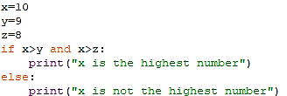
Boolean Operators: AND in Python

Slide 49
Boolean Operators
E.g. Use of OR
x=10
y=9
z=8
if x>y or z>x then
print(“Outcome 1”)
else
print(“Outcome 2”)
endif
What is the output?

Slide 50
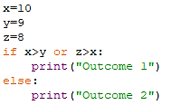
Boolean Operators: OR in Python

Slide 51
Boolean Operators
E.g. Use of NOT
x=10
y=9
z=8
if NOT z>x then
print(”Outcome 1”)
else
print(“Outcome 2”)
endif
What is the output?

Slide 52
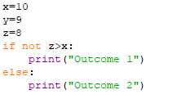
Boolean Operators: NOT in Python

Slide 53
CHECKPOINT
You have been asked to write a program that manages security on the personal details stored on a database. Your program must store a particular person’s username and their password.
When this person tries to login, if their username and password are both entered correctly, they will be allowed to continue. However, if either one of these is entered incorrectly, they will be asked again to enter their username and password again. This will continue until the user name and password are entered correctly.
Change the program so that the person gets three chances to enter the correct username and password. After these three chances they get a message to say that they have been locked out of their account.

Slide 54
CHECKPOINT
Find out whether the following programs output True or False.
7==19 b. 7!=19 c. 7>19 d. 7<19 e. 19>=7 f. 19<=7
2. Find out whether the following programs output True or False.
In all cases x=10 and y=20.
x==y/2 and x>=9 b. y/x==2 and y>=10 c. x+y==20 or y+x==30
d. x>=11 or y>=31 e. not(x+y==30) and y==20
f. not(x+y==30) or y==20

Slide 55
What have we learnt in Unit 2.2 Part 1?

